Slide 1
The Secrets Of Sound
Xiaochi Ge, Wenye Ouyang, Xinyu (Mandy) Zhang

Slide 2
Question and introduce sample dataset
How to use classification models to recognize the gender by voice?
Source: 3168 audio samples from real human voices
Target variable: Label(female/male)
Three different models: KNN, Random Forest, Logistic regression

Slide 3
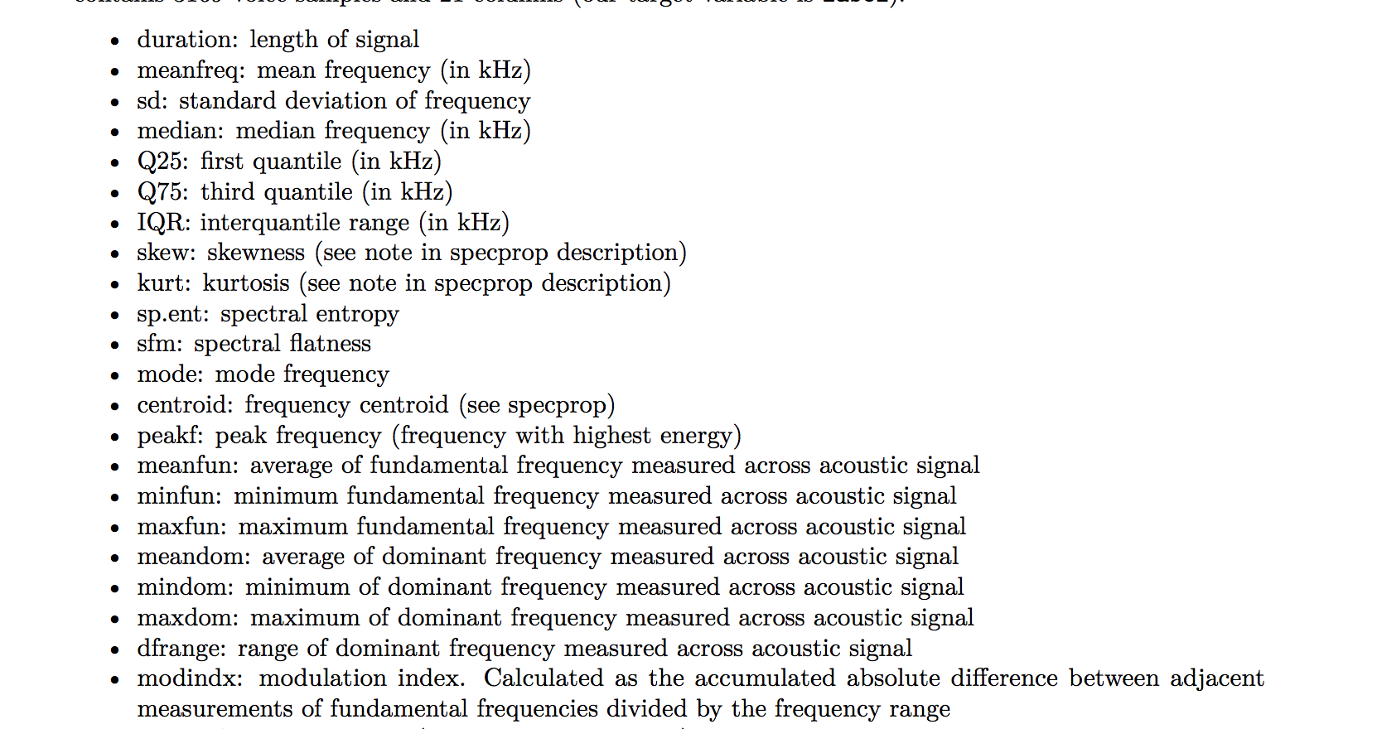
20 Variables

Slide 4
EDA

Slide 5
EDA

Slide 6
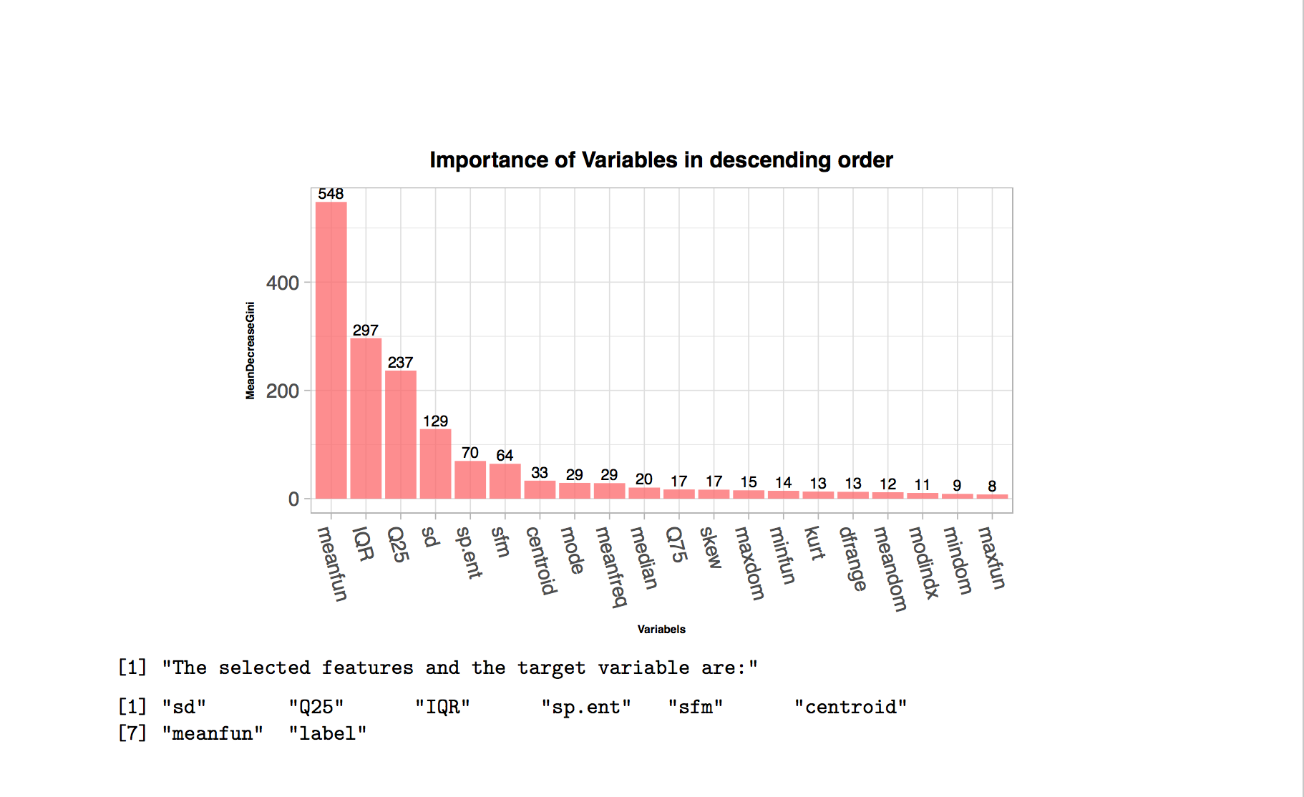
Feature selection： Random Forest Feature Importance
Notes:
No missing values,
All numeric values,
Scale data into 0 mean, 1 sd
Randomly Split data into training and testing into 70% and 30%
Gini impurity is a measure of how often a randomly chosen element from the set would be incorrectly labeled if it was randomly labeled according to the distribution of labels in the subset

Slide 7
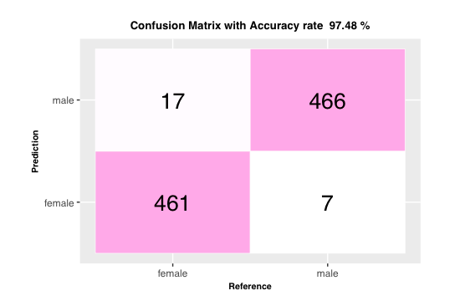
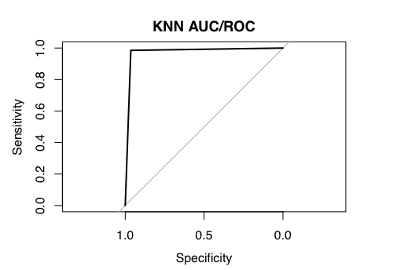
K-Nearest Neighbor Classification
K = 7
Accuracy Rate: 97.48%
Notes:
Reason for high accuracy: data structure is nearly perfect: data is perfectly balanced (gender are 50/50), no missing values.
Set parameter k = 7. When k=7, compared to other k values, the accuracy reach the highest.
The accuracy rate is 97.48%, which is around 97%.
Use the Elbow method, we find that this left corner is like right angle, which is 90 degrees. It tells us that this model is a good model.

Slide 8
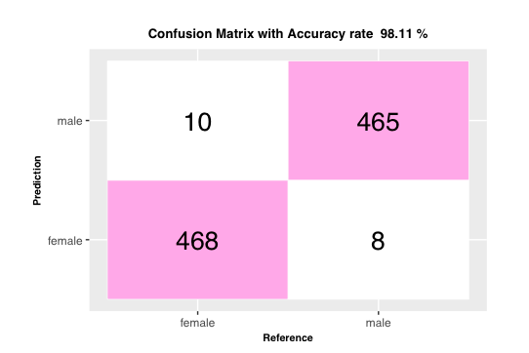
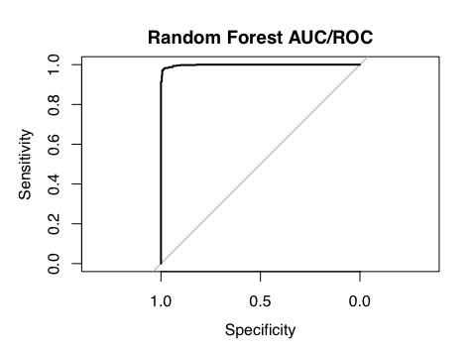
Random Forest classification:
Accuracy Rate: 98.11%
Number of variables selected at each split = 4 with the lowest forest error rate.
Number of tree = 350
Notes:
number of variables selected at each split = 4 with the lowest forest error rate. , number of tree = 350

Slide 9
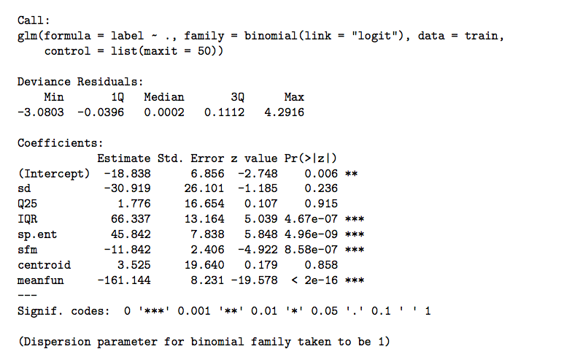
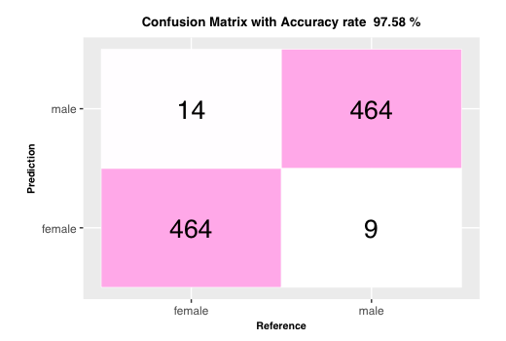
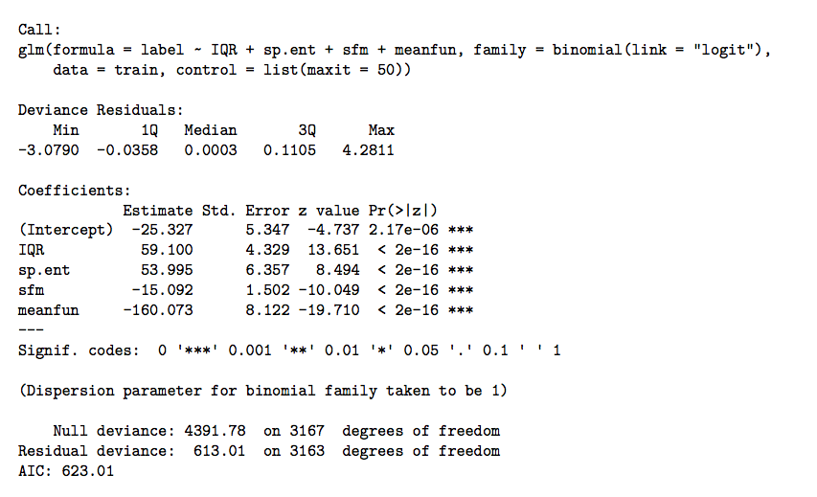
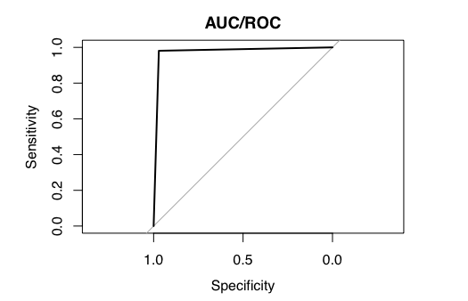
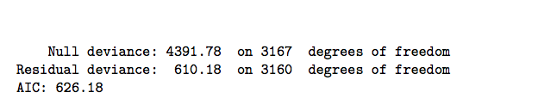
Logistic Regression Model:
Accuracy Rate: 97.58%
Notes:
Based on the summary table above, the P-values of sd, Q25 and centroid are larger than 0.05, which means
those variables are not significant. Therefore, those variables need to be removed in the next model.
The Residual deviance increase from 610.18 to 613.01, which means the model is fitting good.
the AIC dropped from 626.18 to 623.01, which means the this model is fitting good as well.

Slide 10
In class experiment
Time to test the accuracy of our model!
Volunteers Wanted!
Notes:
After finishing the major parts of the project, we are still curious that what we can do next to make our machine smarter. What if people disguise their voice? What if we add some feigned voices into the dataset? Can this machine still do a good job?
For feature selection, there might be some better algorithms to perform dimension reduction such as principal component analysis (PCA) or independent component analysis (ICA).

